Slide 1
HL-HGAT Demo
Jinghan Huang
National University of Singapore
Google colab
Notes:
Hello everyone. This morning, we presented the theory behind the HL-HGAT model. In this session, we will show how to implement the proposed model using PyTorch.

Slide 2
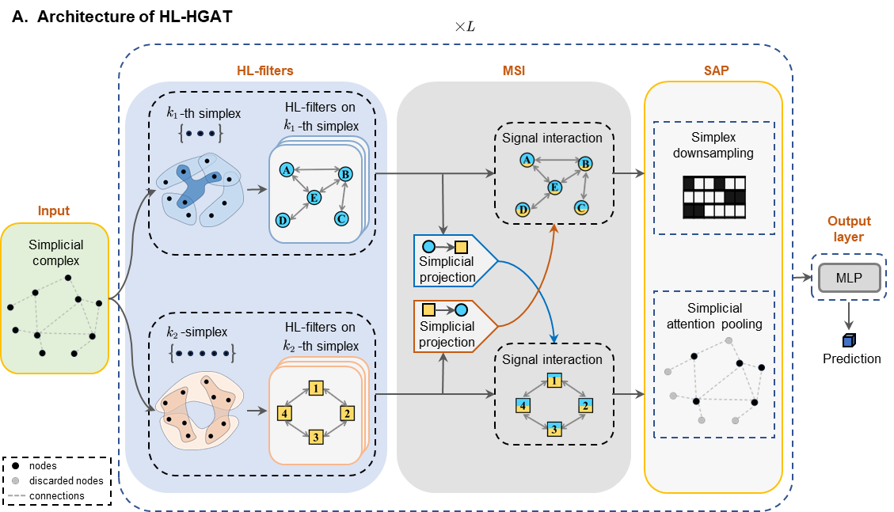
HL-HGAT for the Prediction of Sex

Slide 3
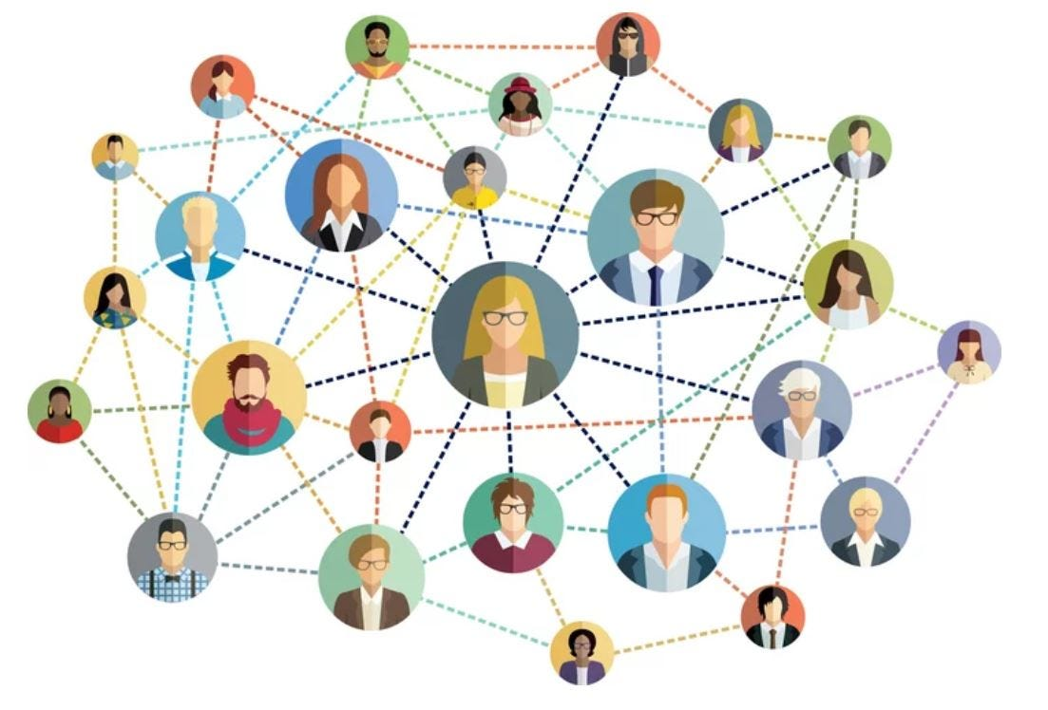
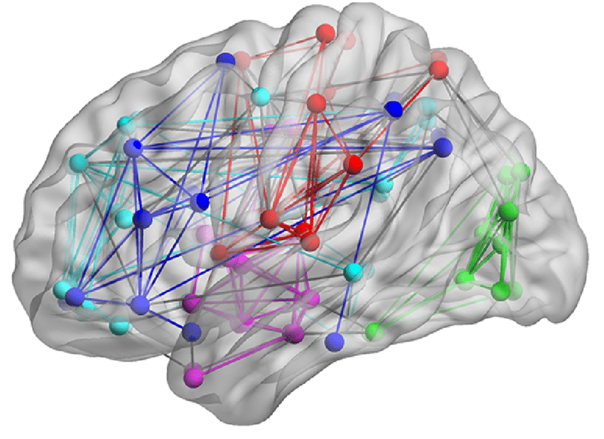
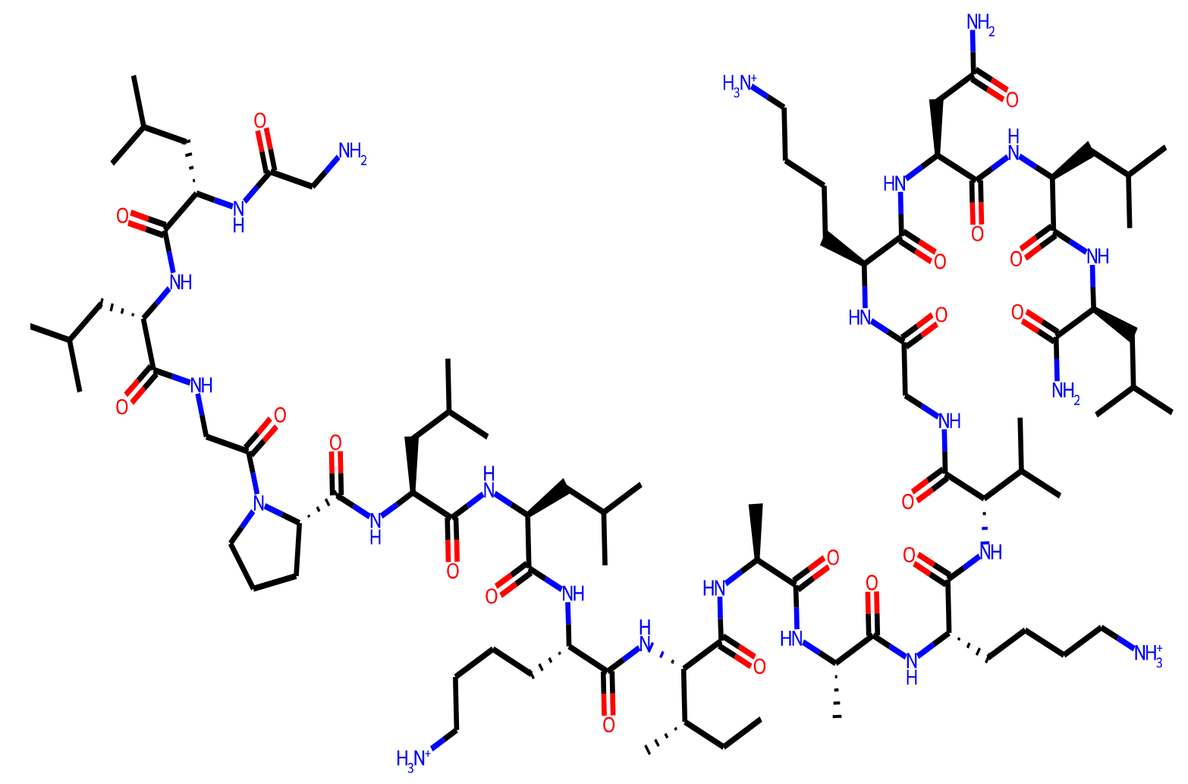
Graphs in Different Applications
Molecular Science
Social Network
Brain Network
[1] Dwivedi, V. P., Rampášek, L., Galkin, M., Parviz, A., Wolf, G., Luu, A. T., & Beaini, D. (2022). Long range graph benchmark. Advances in Neural Information Processing Systems, 35, 22326-22340.
[2] Retrieved from https://medium.com/analytics-vidhya/social-network-analytics-f082f4e21b16
[3] AlMousa, M., Benlamri, R., & Khoury, R. (2022). A novel word sense disambiguation approach using WordNet knowledge graph. Computer Speech & Language, 74, 101337.
Notes:
Graph is a complicated and irregular data type, widely used to model molecules, social networks, and brain networks.

Slide 4
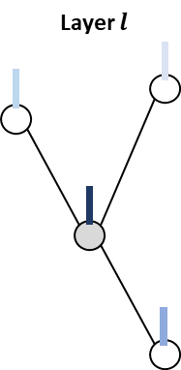
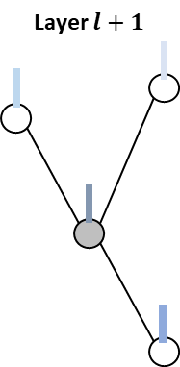
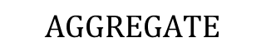
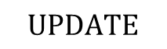
Message Passing Graph Neural Networks (GNN)
$$UPDATE$$
$$AGGREGATE$$
AGGREGATE is the function that aggregates features from a set of neighborhood nodes.
UPDATE is the function that updates the representation of the node from the aggregated features.
Notes:
Previous works use MPGNNs to model this kind of complex and irregular data. MPGNNs define the convolution operation by first

Slide 5
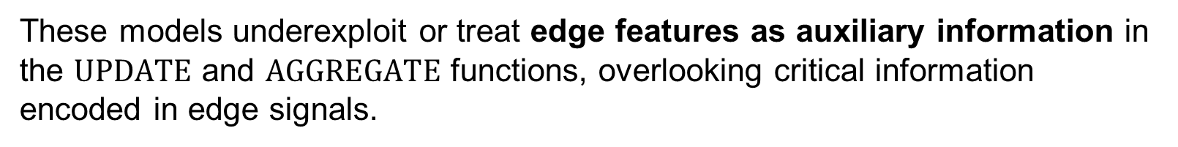
Limitations of GNNs with Node Filtering
These models underexploit or treat edge features as auxiliary information in the $UPDATE$ and $AGGREGATE$ functions, overlooking critical information encoded in edge signals.
Lately, a few studies have focused on smoothing edge signals through the topological connection of edges.

Slide 6
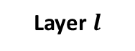
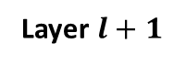
Leveraging Heterogeneous Graphs for Diverse Information Representation
Node Signals:
Functional time series.
Functional connectivity.
Graph metrics
Layer $l$
Layer $l+1$
Edge Signals:
Functional connectivity
path length
Heterogeneous graphs enable the incorporation of multiple features defined across various node categories, enhancing the representation of complex data relationships.

Slide 7
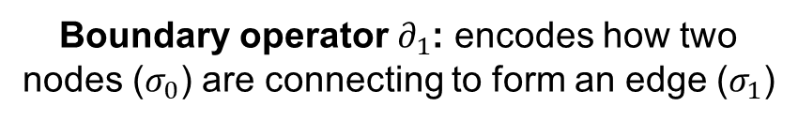
Simplex and Boundary Operator
Simplicial Complex
Boundary operator $∂_{1}$: encodes how two nodes ($σ_{0}$) are connecting to form an edge ($σ_{1}$)
Notes:
Mathematically, nodes and edges are called 0− and 1−dimensional simplex.

Slide 8
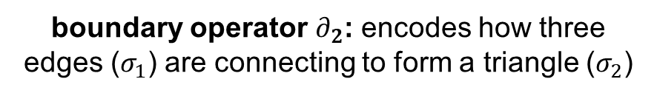
Simplex and Boundary Operator
Simplicial Complex
boundary operator $∂_{2}$: encodes how three edges ($σ_{1}$) are connecting to form a triangle ($σ_{2}$)

Slide 9
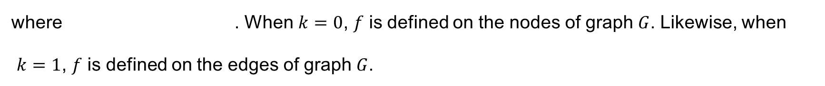
Hodge-Laplacian Operator and Spectral Filtering
We define k-th Hodge-Laplacian (HL) operators as
We can obtain orthonormal bases by solving eigensystem . A generic form of spectral filtering of a signal f on a heterogeneous graph G can be defined as
where . When $k=0$, $f$ is defined on the nodes of graph $G$. Likewise, when
$k=1$, $f$ is defined on the edges of graph $G$.
Notes:
The spectral filtering of a signal f on the heterogeneous graph G can be defined by first transforming the signal to the spectral domain, then filtering based on their frequency.

Slide 10
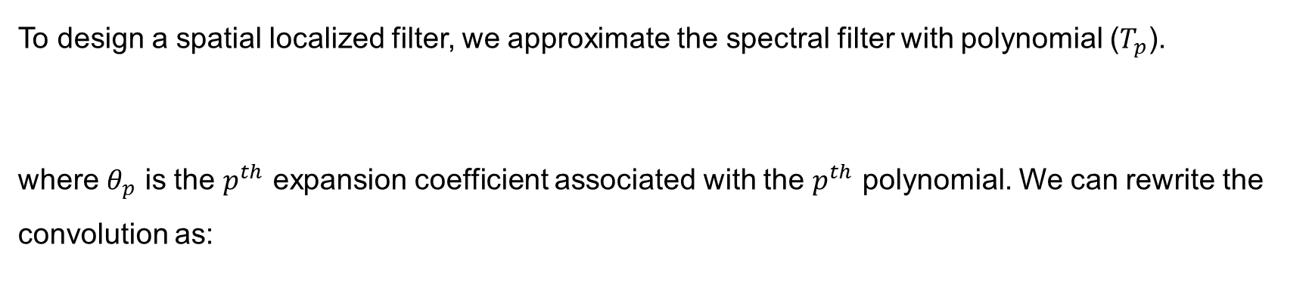
Polynomial Approximation of the HL Spectral Filters
To design a spatial localized filter, we approximate the spectral filter with polynomial ($T_{p}$).
where $θ_{p}$ is the $p^{th}$ expansion coefficient associated with the $p^{th}$ polynomial. We can rewrite the convolution as:
In this paper, we use Laguerre polynomial, which can be computed from the recurrence relation of
with and .
Notes:
We can rewrite the convolution as the combination of p-th Laguerre polynomial of the k-th hodge-laplacian

Slide 11
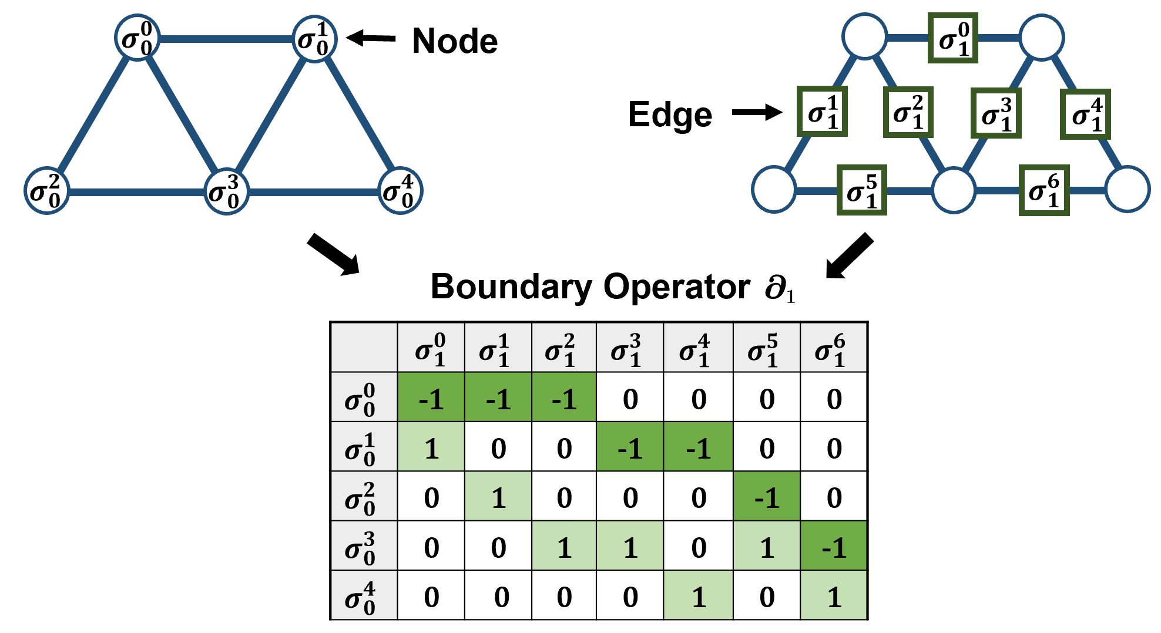
Input data
Node Features:
Functional time series (fMRI)
Cortical morphometry (T1)
Node degree
Edge Features:
Functional connectivity (fMRI)
Structural connectivity (DTI)
Anatomical distance (T1)
Notes:
As introduced this morning, we model the brain network with a heterogeneous graph instead of a traditional graph because we have diverse features defined on both nodes and edges. For example, ...

Slide 12
Input data
Node Features:
Functional time series (fMRI)
Cortical morphometry (T1)
Node degree
Edge Features:
Functional connectivity (fMRI)
Structural connectivity (DTI)
Anatomical distance (T1)
Notes:
As introduced this morning, we model the brain network with a heterogeneous graph instead of a traditional graph because we have diverse features defined on both nodes and edges. For example, ...

Slide 13
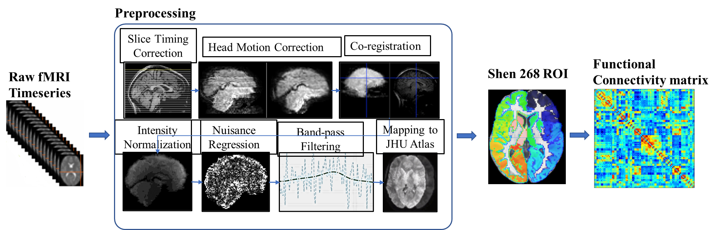
Resting-State FMRI Processing

Slide 14
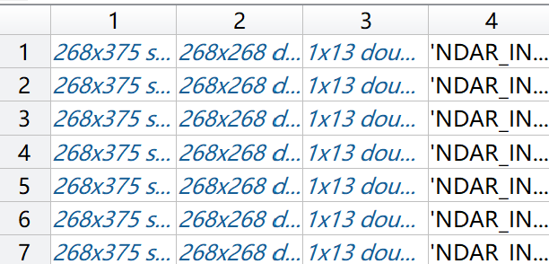
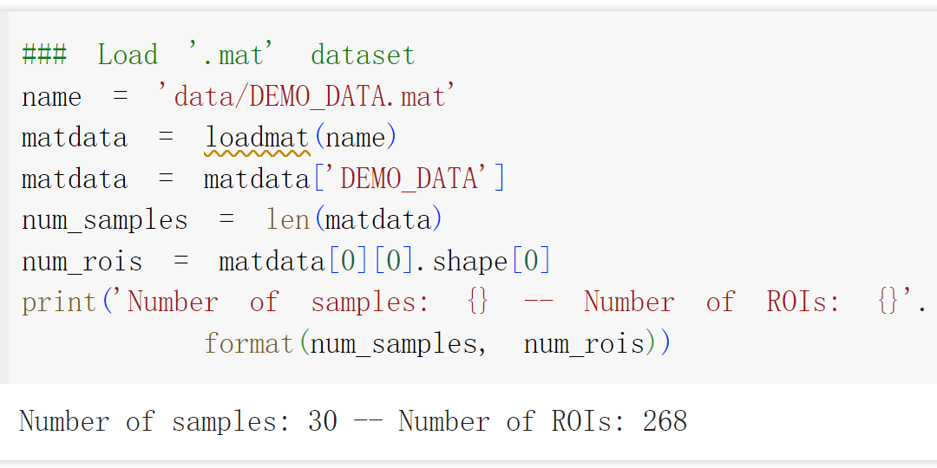
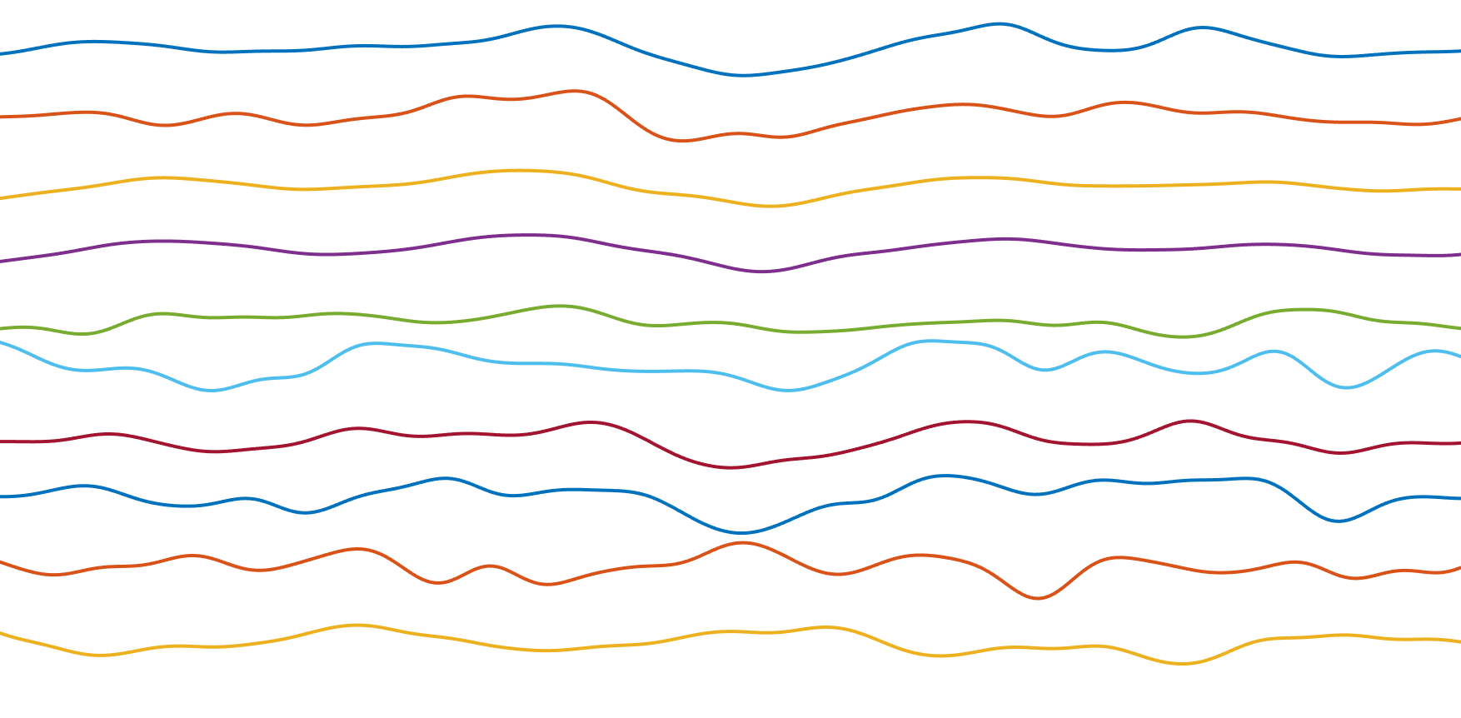
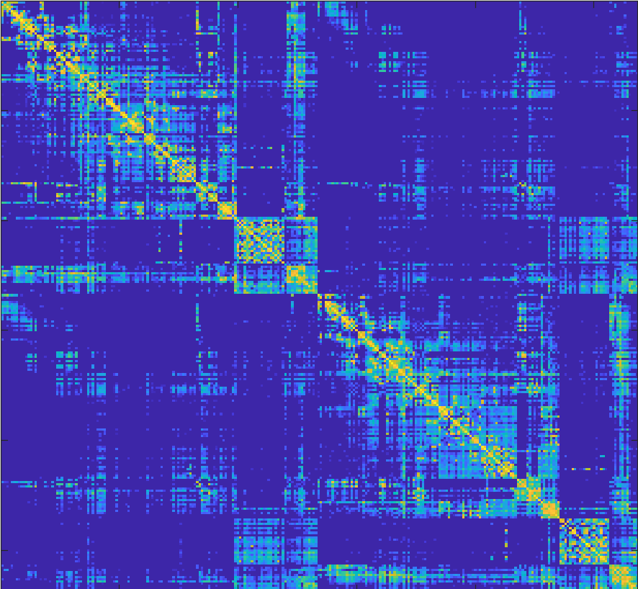

Data Structure
$N×4$ MATLAB cell matrix
Build heterogeneous graph with brain fMRI
Subject ID
[age, sex, general intelligence, …]
Subject Information
fMRI time series
Functional connectivity

Slide 15
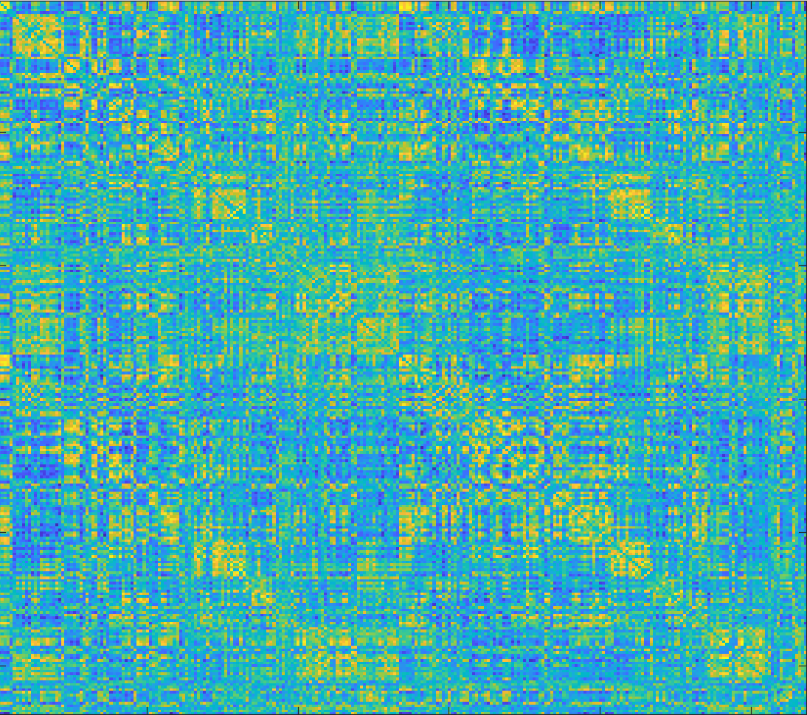
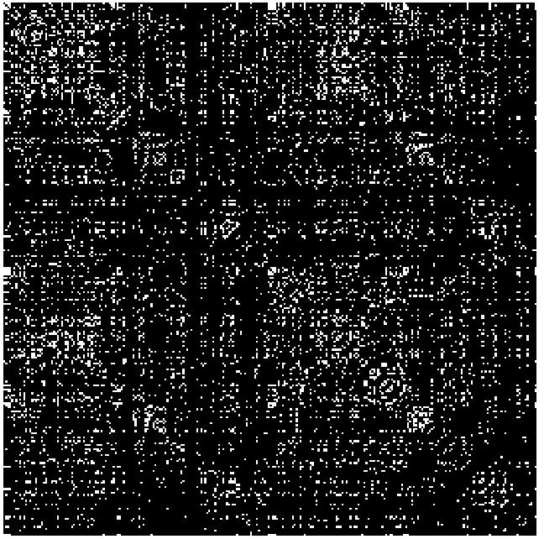
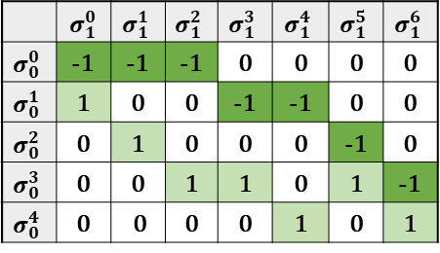
Build filters for node and edge features
fMRI time series on ROIs
Functional connectivity computed by Pearson correlation
Binary mask
Boundary operator
Node Feature
Edge Feature
Hodge-Laplacian operators
Filters for node and edge features

Slide 16
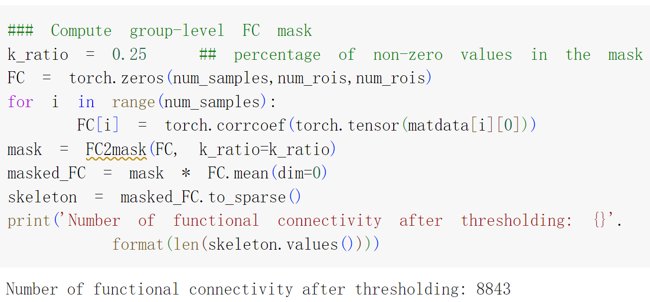
fMRI time series on ROIs
Functional connectivity computed by Pearson correlation
Binary mask computed by thresholding

Slide 17
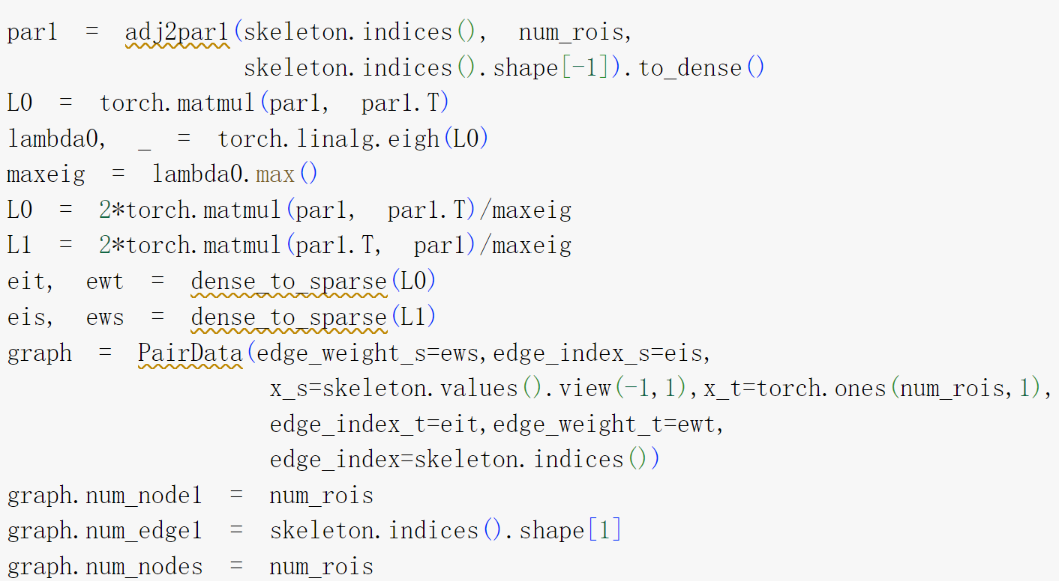
Hodge-Laplacian operators
Binary mask computed by thresholding
Boundary operator
1-st Hodge-Laplacian operator
Edge and node feature
0-th Hodge-Laplacian operator
Boundary operator

Slide 18
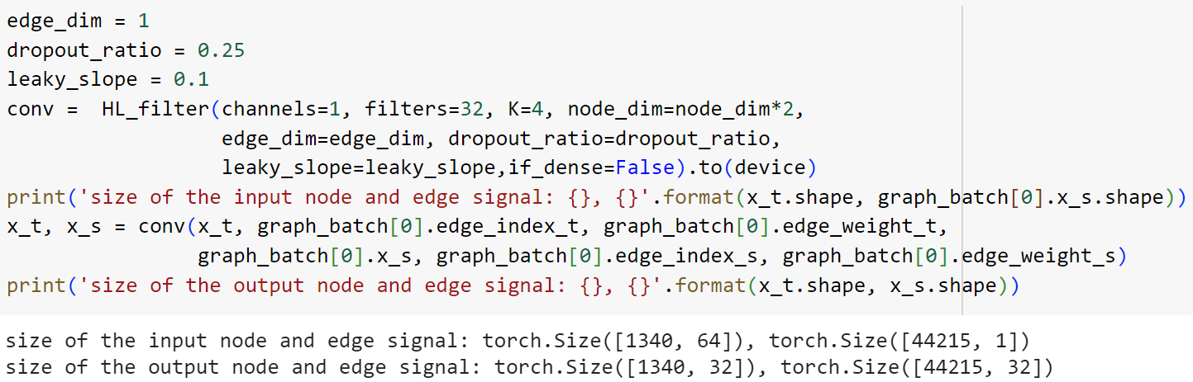
HL-HGAT modules
HL-filters: Convolutional layer on node and edge signals

Slide 19
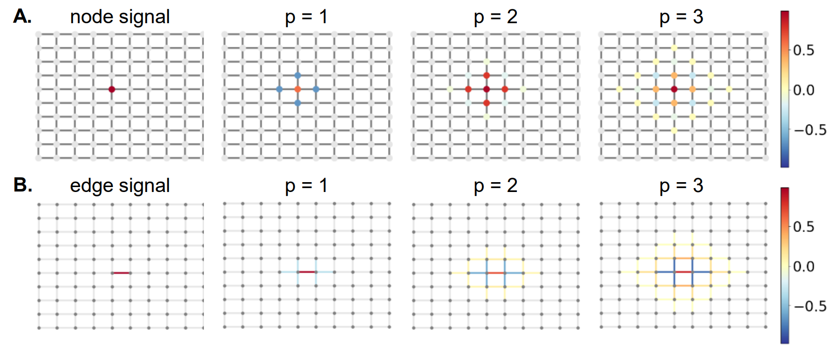
HL-filters: Convolutional layer on node and edge features
p = K - 1

Slide 20
Multi-simplicial interaction layer
MSI: multi-simplicial interaction layer. (Enable modeling feature interactions between node and edge)

Slide 21
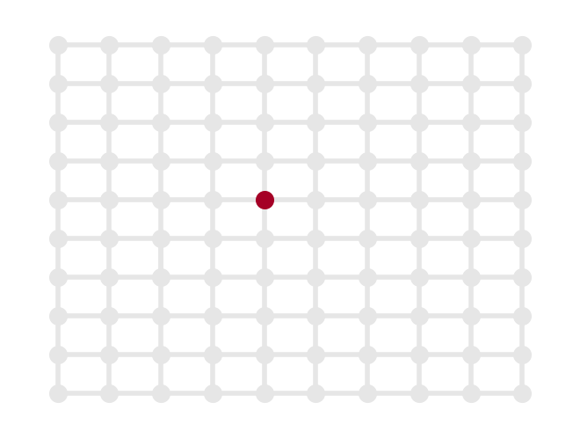
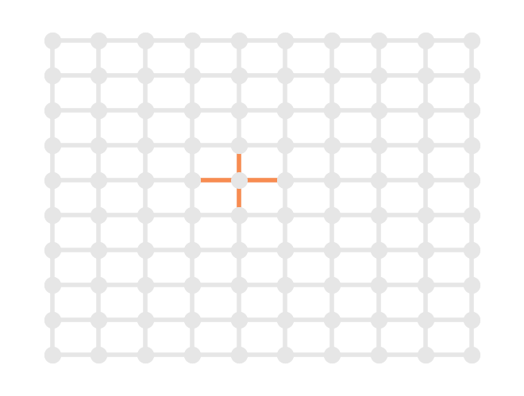
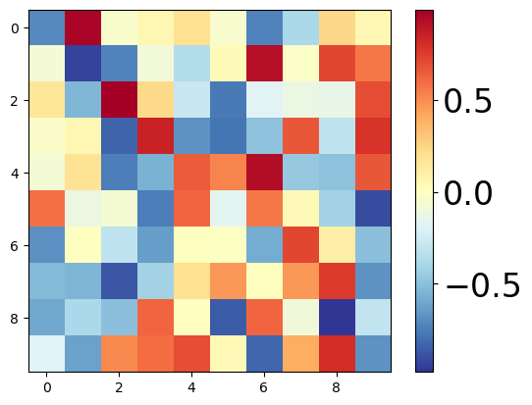
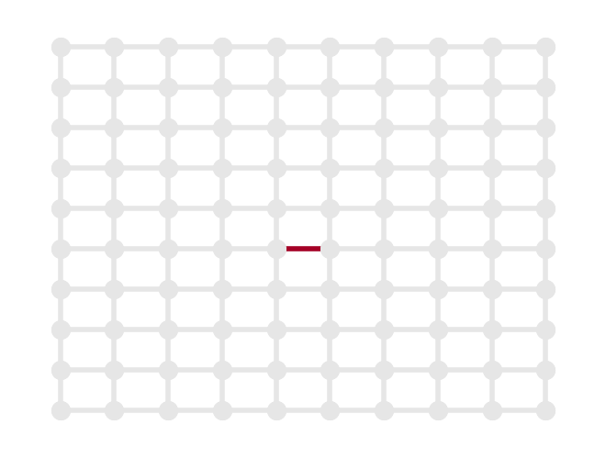
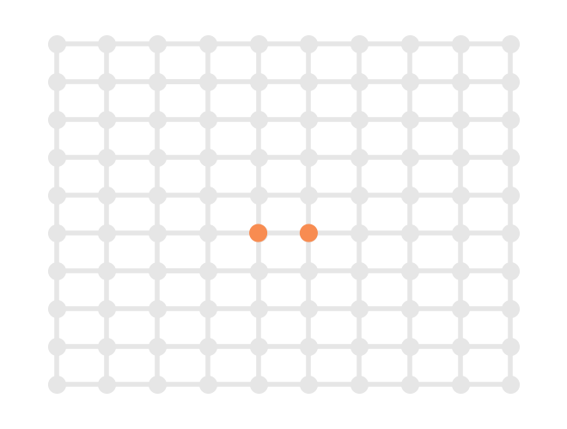
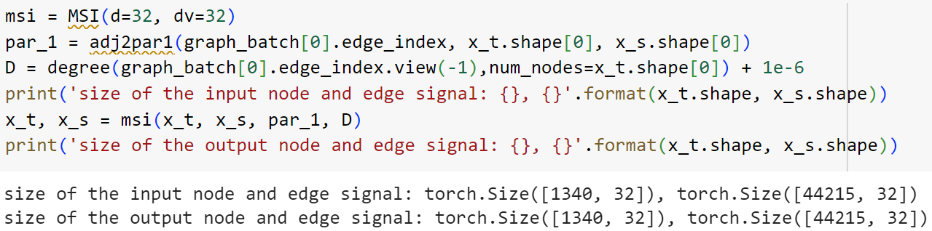
Multi-simplicial interaction layer
node signal
node-to-edge signal
MSI: multi-simplicial interaction layer. (Enable modeling feature interactions between node and edge)
MSI
edge signal
edge-to-node signal

Slide 22
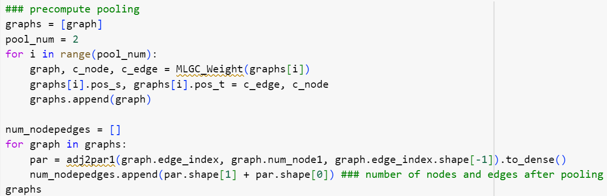
Simplex downsampling
Number of nodes roughly divided by 2 after one pooling layer
Number of edges roughly divided by 4 after one pooling layer

Slide 23
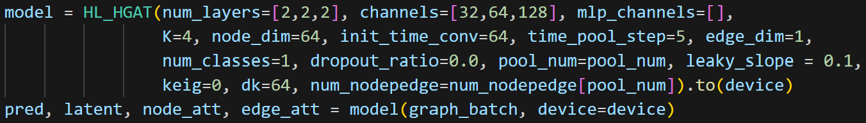
Construct HL-HGAT
HL-HGAT model consists of multiple blocks. The number of these blocks is determined by the num_layers variable.
HL-HGAT with three blocks. Each block contains two convolutional layers
Notes:
For example, to construct an HL-HGAT with two blocks — where the first block has one convolutional layer and the second block has three — we simply set num_layers = [1,3]. Similarly, the code shown in the right figure constructs an HL-HGAT with three blocks, each containing two convolutional layers.

Slide 24
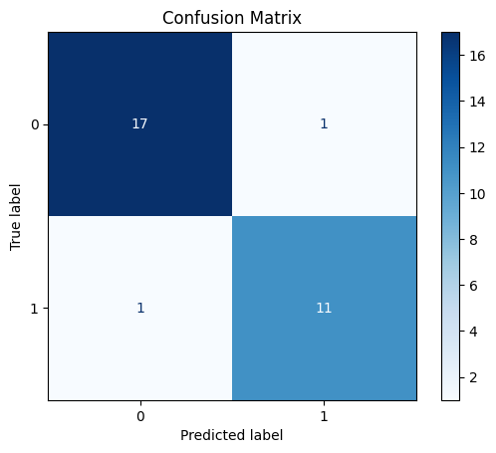
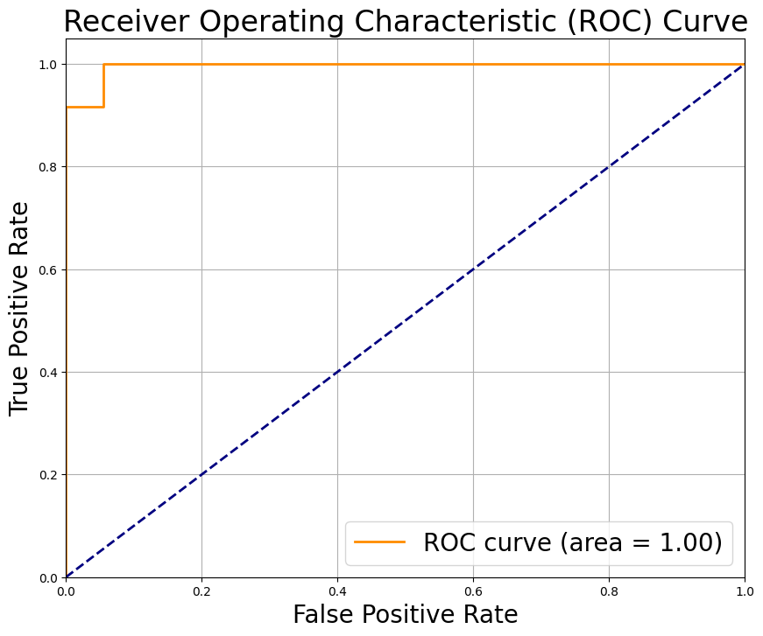
Visualization
Prediction Result: Used for both training and testing phases.

Slide 25
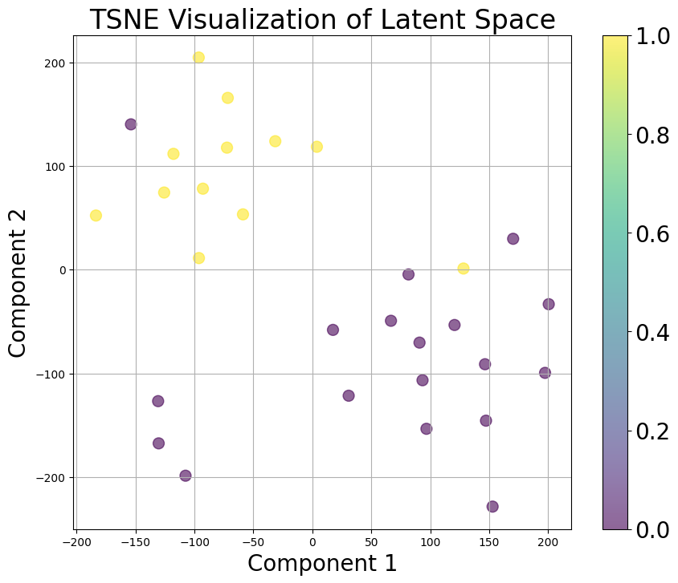
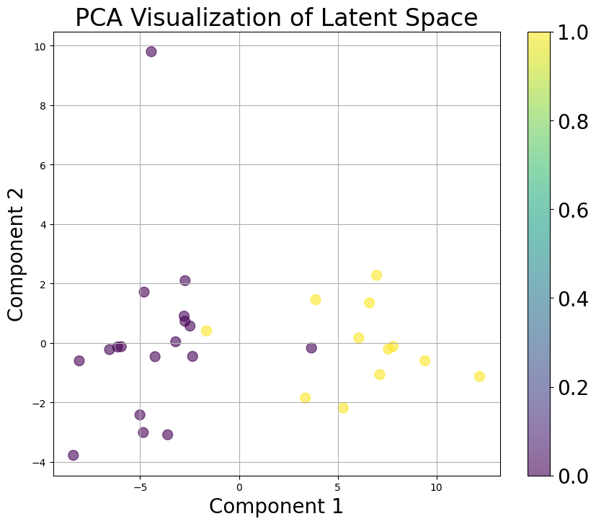
Visualization
Latent Representation: A low-dimensional representation from the final layer, suitable for t-SNE visualization, as depicted in the figure.

Slide 26
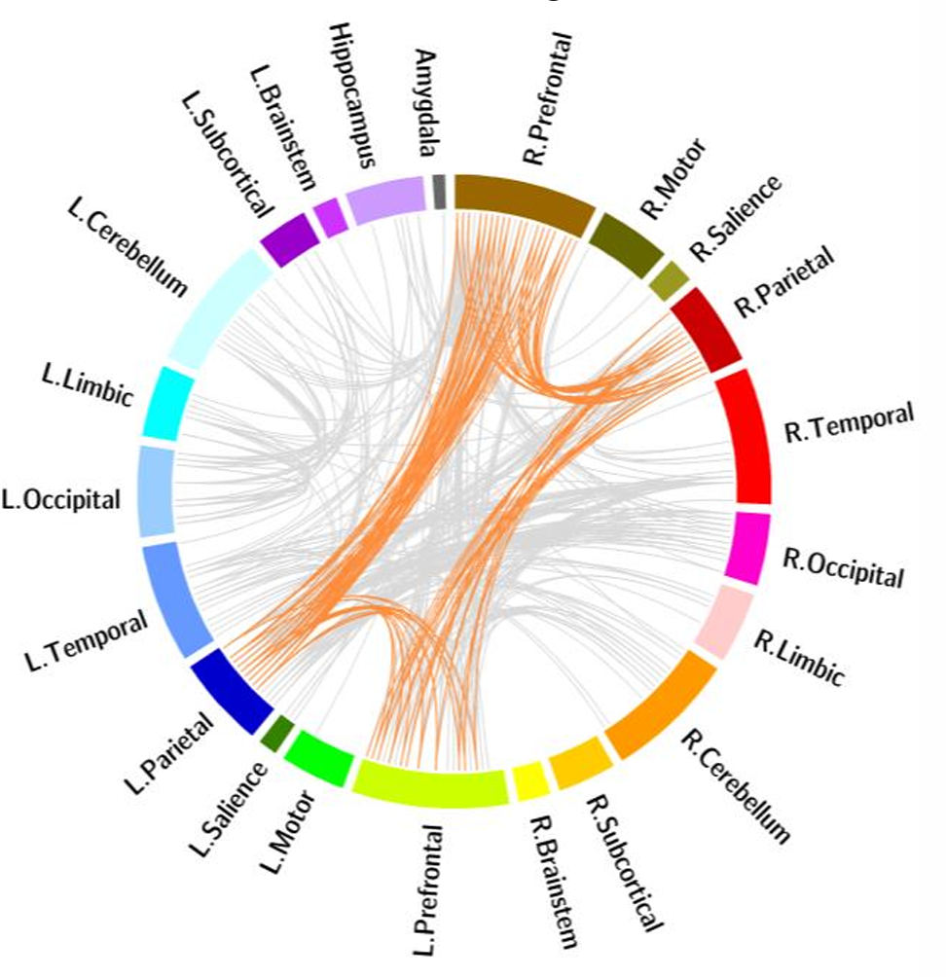
Visualization
Attention Visualizations: node and edge attention computed from the simplicial attention pooling layer (SAP)

Slide 27
Code in Google Colab
https://colab.research.google.com/drive/14SYI5de5xODUhDajUERKumEdqyJe_Mog?usp=sharing
https://github.com/JH-415/HL-HGAT.git
[1] Huang, Jinghan, Moo K. Chung, and Anqi Qiu. "Heterogeneous graph convolutional neural network via hodge-laplacian for brain functional data." International Conference on Information Processing in Medical Imaging. Cham: Springer Nature Switzerland, 2023.
[2] Huang, Jinghan, et al. "Advancing Graph Neural Networks with HL-HGAT: A Hodge-Laplacian and Attention Mechanism Approach for Heterogeneous Graph-Structured Data." arXiv preprint arXiv:2403.06687 (2024).

